Slide 1


Slide 2
The Pre-Submission Process – Step 1
Contact AAFCO: definitions@aafco.org
Share the proposed ingredient, the intended use, and more.
AAFCO will evaluate the inquiry for applicability with SRIS.
AAFCO will either assign the ingredient to the appropriate investigator
Or direct the submitter to the most appropriate pathway (e.g., not applicable, handled under a different regulatory process, or already defined)
Note: if you reach out to AAFCO through another channel or contact K-State Olathe (KSO) directly, you will be referred to the email address above.

Slide 3
The Pre-Submission Process – Step 2a
Work with the appropriate AAFCO Investigator
Cursory review of the material, the intended use, and relevant data needed for a submission
If applicable, the investigator will notify the SRIS Program Manager of the intent to submit and what the applicable package level should be.
The submitter may also request a pre-consultation meeting with the KSO SRIS Representative at this time.

Slide 4
The Pre-Submission Process – Step 2b
The SRIS Program Manager will provide the submitter with a proposed cost estimate for the review.
The proposed invoice will include:
The estimated cost of the review
An intent to submit/intent to cancel selection line, and
A signature line for authorization
The submitter 14 days to review the proposed cost and indicate their intent to submit a full dossier
Needed: Signature from Submitter’s authorized representative accepting the proposed cost and intent to submit.

Slide 5
The Pre-Submission Process – Step 2b
Note
Acceptance of the proposed cost represents intent to submit a full dossier and does not initiate the SRIS review.
Upon acceptance of the proposed cost, the submitter must:
confirm that a complete submission will be provided within (8) months, and
provide an approximate month for dossier submission.
The proposed cost estimate remains valid for 8 months from issuance, after which it may be revised.
SRIS will not convene an SME panel until:
a firm anticipated submission date is confirmed, and
SRIS is notified at least 30 days prior to submission.
Failure to meet the stated notification or submission timeline may result in:
delays to the projected review timeline, and
the need to reassess cost estimates.

Slide 7
The Pre-Submission Process – Step 3
Submitter completes ingredient submission package
Materials submitted for review
Submitter presents ingredient submission to the SRIS Program via a secure submission site provided by AAFCO.

Slide 8
SRIS Process Flow (Steps 1-3)
Definitions@aafco.org
Assigned to Investigator & Pre-Consultation Meeting
Cost Proposal Provided to Submitter
Materials Submitted to AAFCO
Yes
Yes
Yes
No
No
Sorry
Sorry

Slide 9
Step 3: Submission of Materials to SRIS
Submitter uploads ingredient submission via AAFCO secure submission site
Submission routed to SRIS Program
Initial Completeness Review
Conducted jointly by:
AAFCO Investigator
SRIS Program Manager and/or SRIS Scientific Lead
Focus:
Required sections present
Materials organized and reviewable
Outcome:
Submission accepted for SRIS processing
OR submitter contacted if deficiencies are identified

Slide 10
Step 4: SME Panel Identification
Panelist Identification
Led by K-State Olathe (SRIS Program)
Review SRIS SME database using area of expertise keywords
Targeted recruitment outside database may occur if needed
All candidates must submit required eligibility documentation
Eligibility & Compliance Checks
Curriculum Vitae (CV)
Conflict of Interest (COI) review conducted
Annual SME training verified as current
Contracting
Updated COI and disclosures collected, if needed
Contracts issued to selected SME panelists for signature

Slide 11
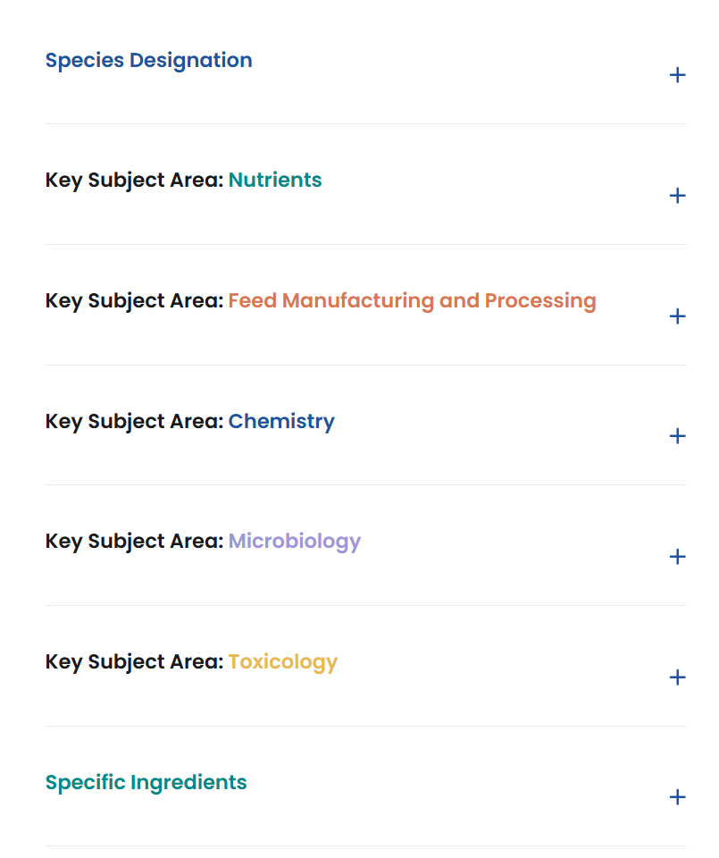
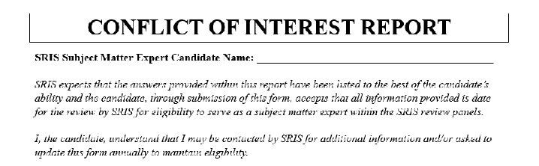
Who are the SRIS reviewers?
Pool of subject matter experts (SMEs) from:
Universities,
Independent consultancies
Industry (when appropriate)
Open application requiring submission of:
Curriculum vitae
Areas of expertise designation(s)
Conflict of Interest (COI) form
Eligible candidates granted access to SRIS developed regulatory training modules (online)
Eligibility determined by
3-Tier Evaluation Criteria established by SRIS Steering Committee

Slide 12
Step 5: Invoicing & Authorization to Proceed
AAFCO issues formal invoice to submitter
Payment submitted to AAFCO:
AAFCO payment link
Bank transfer
Check
Payment must be received before SRIS review begins

Slide 13
Step 6: Initiation of Scientific Review (90-Day Review Clock)
Upon payment confirmation:
AAFCO notifies SRIS Program Manager
Submission materials provided to all SME panelists
90-day SRIS review clock is initiated

Slide 14
Step 6 (continued): Preliminary SME Review & Stop Clocks
SME panelists assess submission completeness
Preliminary completeness review (First 14 Days)
Identification of:
Missing information
Clarification needs
Stop Clock – Additional Information Requests
SRIS may request additional materials from submitter
Up to 30 days (max) per request
Additional time may be granted case-by-case
Submitter can upload materials to AAFCO secure site if asked

Slide 15
Step 6 (continued): Independent Reviews & Panel Discussion
Independent SME Reviews
SME panelists submit preliminary independent review documents:
General recommendation
Scientific notes
Clarification questions
Due within 30 days of material access (unless stop clock active)
Panel Communication initiated
SME discussion conducted via Basecamp
Clarification questions consolidated and sent to submitter, if needed
Up to 14-day stop clock

Slide 16
Step 6 (continued): Independent Reviews & Panel Discussion
Final SME Reviews
Individual SME reviews completed and submitted within 60 days
SRIS convenes full panel meeting to discuss findings and conclusions
Report drafted by SRIS program manager to reflect the conclusions of all panelists convened.

Slide 17
Step 7 - Scientific Review Process Target 90 d
Materials provided to panelists
Initial Review by panelists
Panelist preliminary independent review
Panelists discuss preliminary findings
Panelists convened for discussion with SRIS
Meeting notes drafted as SRIS report
If needed, SRIS will request additional information (could trigger stop clock)
If needed, SRIS will ask clarifying questions or request additional information or (could trigger stop clock)

Slide 18
Step 6 (continued): Report Development
SRIS Full Scientific Report
Drafted by SRIS Program Manager
Based on:
Panel meeting discussion
Independent SME reviews
Reviewed by SRIS Scientific Lead
Approved and signed by all SME panelists
Maintained by AAFCO for recordkeeping
Not publicly released

Slide 19
Step 6 (continued): Report Development
Recommendation Report
Executive summary reflecting panel conclusions
Drafted by SRIS Program Manager
Reviewed by SRIS Scientific Lead
Signed by SRIS representative

Slide 20
Step 6 (continued): Report Development
SRIS SME Panel Summary Letter
Plain-language summary of scientific evaluation
Signed by:
SRIS representative
Submitter’s authorized representative
Submitter indicates intent to:
Proceed to IDC, or
Withdraw submission

Slide 21
Submitter Review & Decision
SRIS Full Report and SME Panel Summary Letter provided to submitter
Submitter has 14 days to respond
Submitter Options
Sign acknowledgement and:
Proceed with submission to AAFCO IDC
OR withdraw prior to IDC notification
Report a justified conflict of interest
SRIS may consider repeating the review if warranted

Slide 22
Step 8: Submission to IDC & Record Archiving
Recommendation Report and Signed SME Summary Letter provided to AAFCO Investigator
Materials submitted to IDC
Considered at the next IDC meeting
Allowing time for public comment
Record Retention
Upon conclusion of review:
All materials archived in AAFCO records
Applies whether recommendation proceeds or is withdrawn
Records may be requested by state regulators if questions arise

Slide 23
Step 9. What happens after the expert panel recommends acceptance?
Investigator reviews the panel’s recommendation. Any adjustments needed?
Questions that investigator has should be answered at this time. Common name? Does the definition make sense, and does it look appropriate for an AAFCO definition?
Investigator finalizes the investigator report and submits it to the IDC Chairs by the meeting agenda deadline.

Slide 24
Step 10. Ingredient Definition Committee
Will have a motion to accept the new or modified definition as official.
Discussion- time for any questions or concerns from the committee and other stakeholders.
Vote by the committee members.
Once meeting minutes are finalized, the committee actions are passed to the Board of Directors for acceptance.

Slide 25
Step 11. Association Membership
BOD recommendations for new definitions get passed to membership through the business meeting.
Membership votes - Majority rules. In a close vote, we must count the votes. Each voter (1 from each participating state and federal agency) will answer to the roll call and log their vote.

Slide 26
Step 12. Official Publication (The End!)
Investigator ensures the newly passed definitions are correctly added to the updated Chapter 6 in the OP.
If anything is replaced/deleted, the investigator of that section is responsible to ensure the edits are correct.
When the association management firm requests the investigators review the edits to chapter 6, each investigator must review their section and ensure all changes have been made.

Slide 27
Panel Discussion and Questions

